Slide 1
10/17/22

Slide 2
Palindrome Review
Chapter 4.3

Slide 3
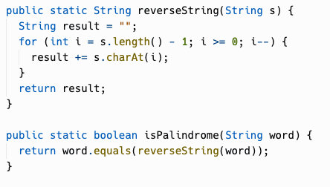
isPalindrome() by reversing
On the Palindrome exercise, this was the most common solution.
Compare the string to its reverse to see if it's a palindrome. It works!

Slide 4
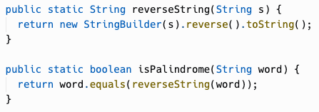
isPalindrome() using StringBuilder
We saw the StringBuilder class last week, which can build up Strings using mutable operations. It has a built-in reverse() method, letting us do the check with very little code.

Slide 5
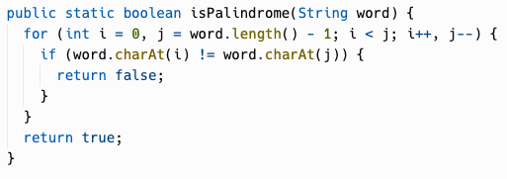
isPalindrome() using direct comparison
Reversing the string requires allocating memory. We can avoid this by directly comparing the characters in the original string.
Most string loops you've seen so far have a single counter.
This one starts two counters, one at each end of the string, and "races" them toward the middle until they meet, which ends the loop.

Slide 6
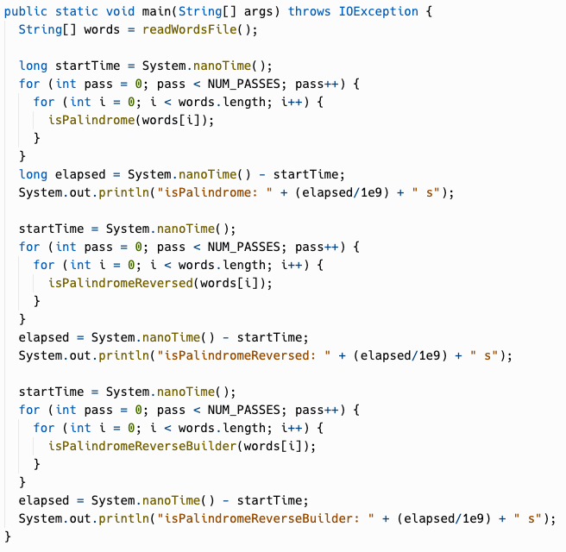

isPalindrome benchmark
Reversing the string through concatenation (isPalindromeReversed) generates many String instances which get discarded immediately (garbage objects).
isPalindromeReverseBuilder (StringBuilder) is ~4X faster than isPalindromeReversed
isPalindrome with no string reversal is ~8X faster than isPalindromeReversed

Slide 7
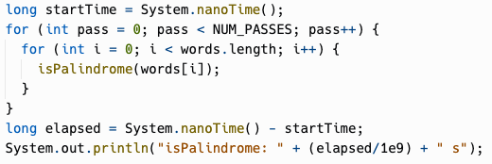
Benchmark nested loop
Computers are so fast that you may have to benchmark a method millions of times to get a good reading.
Here, we use a nested loop to run through the entire EOWL word list multiple times. (NUM_PASSES is set to 10, and words.length is 128985)
The computer was able to go through a dictionary 10X in 0.0295 seconds = 29.5 milliseconds!

Slide 8
Performance Optimization
Analyzing your code and making improvements to make it faster and/or use less memory is called optimization.
Not every piece of code needs to be optimized to the max…
There are trade-offs to evaluate:
How much of my time do I want to spend making it faster or less memory-intensive?
Is a more naive algorithm simpler to understand for other programmers?
How will the code actually be used IRL?
However, sometimes you think your code will only have to deal with 1,000 records, and then the company gets some big customer and the same code is subjected to 1,000,000 records!
Java and other languages have compiler optimizations that make your code faster automatically… but these optimizations aren't able to change the fundamentals of your algorithms.

Slide 9
Nested Loops
Chapter 4.4

Slide 10
Nested Loops
A nested loop is a loop inside another loop, possibly >2 levels.
for(int i = 0; i < 5; i++) {
for(int j = 0; j < 3; j++) {
System.out.print(j);
}
System.out.println();
}

Slide 11
Nested Loops
A nested loop is a loop inside another loop, possibly >2 levels.
outer loop
for(int i = 0; i < 5; i++) {
for(int j = 0; j < 3; j++) {
System.out.print(j);
}
System.out.println();
}
inner loop
could be
some
other
code
too

Slide 12
Rows and Columns
for(int i = 0; i < 5; i++) { for(int j = 0; j < 3; j++) { System.out.print(j); } System.out.println(); }
i = 0
j = 0
j = 1
j = 2
The outer loop iterates through the rows
The inner loop iterates through the columns
The inner loop runs in its entirety on each iteration of the outer loop
i = 1
j = 0
j = 1
j = 2
i = 2
j = 0
j = 1
j = 2
i = 3
j = 0
j = 1
j = 2
i = 4
j = 0
j = 1
j = 2

Slide 13
Tracing Nested Loops
i | j
0 | 0
0 | 1
0 | 2
1 | 0
1 | 1
1 | 2
2 | 0
2 | 1
2 | 2
3 | 0
3 | 1
3 | 2
4 | 0
4 | 1
4 | 2
for(int i = 0; i < 5; i++) { for(int j = 0; j < 3; j++) { System.out.print(j); } System.out.println(); }

Slide 14
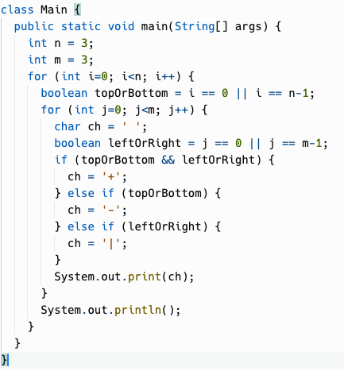
Notes:
We'll trace through this loop in class

Slide 15
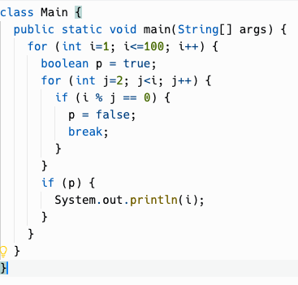
Inner loop can depend on outer loop
Notes:
Still essentially a nested loop although one loop is in a method that is called
We'll trace through this loop in class

Slide 16
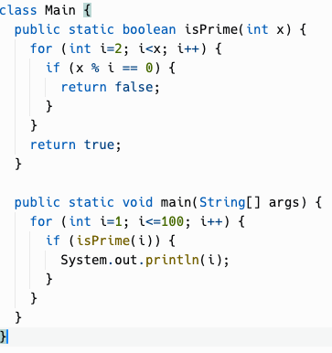
Finding Prime Numbers
This code does the same thing, less cryptically.
How many loop iterations does this code do?
Is this algorithm efficient?
Notes:
Still essentially a nested loop although one loop is in a method that is called
The number of loop iterations that happens is the same; the program will take the same amount of time (with a little bit added for the method call overhead)
Is this algorithm efficient? The running time is proportional to N^2, where N is the highest number you're checking to be prime.
N^2 grows very quickly. It's fine for small values of N but can grow to the point where algorithms can take years to finish.

Slide 17

Sieve of Eratosthenes
A more efficient algorithm was discovered… by a Greek mathematician in the 3rd century BC.
When the numbers are sufficiently large, no efficient non-quantum integer factorization algorithm is known.
Notes:
Still essentially a nested loop although one loop is in a method that is called
We'll trace through this loop in class
The Sieve of Eratosthenes is quite simple, and we may come back and implement it later, but you really need arrays to do it.
Start with knowing 1 is prime. 2 is prime.
2 is prime, so any multiple of 2 is NOT prime… you can mark them all off, up to the limit, as not being prime.
Then the next unmarked number is prime, so, 3 is prime.
Now mark all off multiples of 3 as being NOT prime…
4 will be already marked as not prime, so then 5… and so on.
This sculpture is called the Sieve of Eratosthenes. It's in the sculpture garden on the campus of Stanford University. I suppose it looks like an actual sieve.

Slide 18
Practice!

Slide 19
MultiplicationTable
Fibonacci
FibonacciSpiral

Slide 20
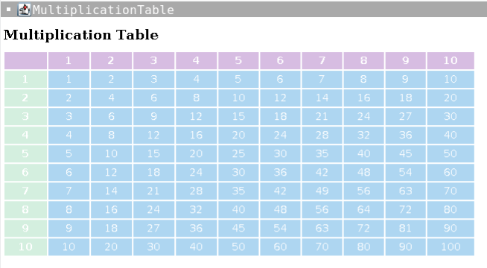
Multiplication Table

Slide 21
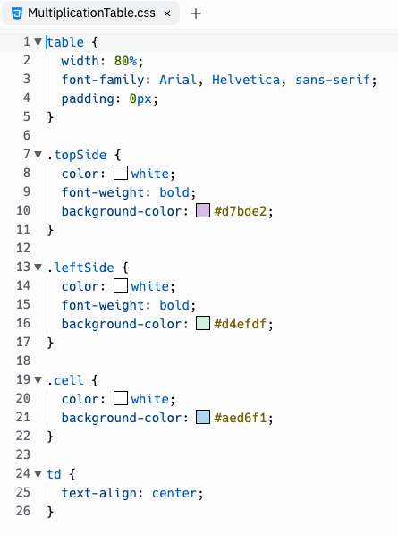
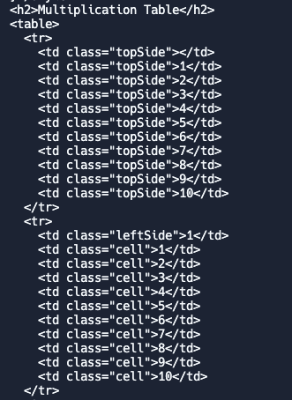
Multiplication Table

Slide 22

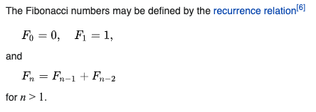
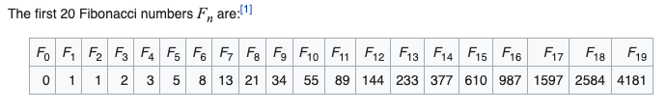
Fibonacci Numbers
Fibonacci (c. 1170 – c. 1240–50) was an Italian mathematician from the Republic of Pisa, considered to be "the most talented Western mathematician of the Middle Ages".
Applications of Fibonacci numbers include computer algorithms such as the Fibonacci search technique and the Fibonacci heap data structure, and graphs called Fibonacci cubes used for interconnecting parallel and distributed systems

Slide 23
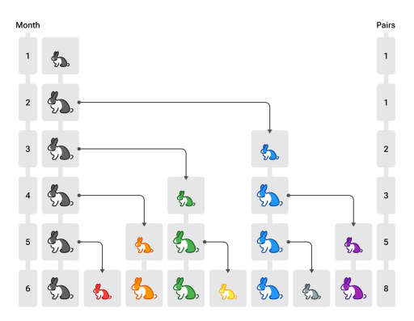
Fibonacci Numbers
Notes:
Fibonacci's original question that he posed when discovering the Fibonacci sequence was "If you start with 1 pair of rabbits in a field, after one year, how many rabbits would there be?"

Slide 24
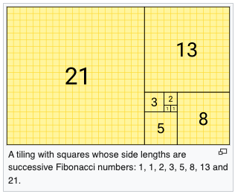
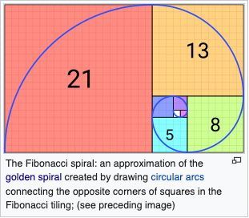
Fibonacci Spiral

Slide 25
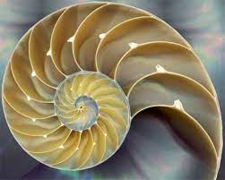
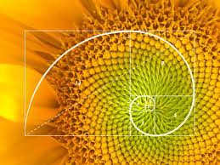



Fibonacci Spiral
Notes:
The Fibonacci Spiral, like other golden spirals, is self-similar … if you magnify it, the same pattern repeats itself infinitely.
The growth rate of the Fibonacci Spiral is the golden ratio phi (~1.618)
The golden ratio and the golden spiral appear in many places in nature… the growth of a nautilus shell, the head of a sunflower, the arms of spiral galaxies.
The golden spiral also appears in graphic design because it is thought to be a pleasing natural phenomenon to the human eye. Modern computer monitors are typically 16:10, approximately the golden ratio.

Slide 26
Example
Write a nested for-loop that prints out a 3 by 3 grid of letters where the letters in the first column are A’s, the letters in the second column are B’s, and the letters in the third column are C’s.
A B C
A B C
A B C

Slide 27
Example
for (int row = 0; row < 3; row++) {
for(int col = 0; col < 3; col++) {
if (col == 0) {
System.out.print(“A”);
else if (col == 1) {
System.out.print(“B”);
} else {
System.out.println(“C”);
}
}
}

Slide 28
Exercise 1
Write a program that asks the user for an integer N. Using nested for loops, print the numbers <= n for each n in 1, …, N. For N >= 4, your first few lines of output should be:
1
1 2
1 2 3
1 2 3 4
...

Slide 29
Exercise 2
Write a program that asks the user for a double R. Use nested for loops to write a program that counts the number of integer-valued points (e.g. (1, 3)) on or inside a circle of radius R.
Hint: If given a circle of radius R, how would you construct a rectangular “search area” that will always contain the entire circle? How can you check if a given integer-valued point is on or inside the circle?
Hint: 0 < R < 1 should give you exactly 1 such point, e.g. (0, 0). R = 1 should give you 5 points [(0, 0), (0, 1), (1, 0), (-1, 0), (0, -1)] and R = sqrt(2) should give you 9 points.
How many points will R = 3 give you?

Slide 30
Exercise 3
Write a program that asks the user for a integer N. Print all of the prime factors of N.
Hint: First identify if each number is a factor of N. If it, use another for loop to determine if the factor is prime.
Why is this algorithm inefficient? At the end of your program, write a comment explaining how you might make it faster (concept only--no code required).

Slide 31
Exercise 1 Answer
public class Diagonal {
public static void main(String[] args){
// excluding scanner for simplicity
int N = 5;
for (int i = 1; i <= N; i++) {
for (int j = 1; j <= i; j++) {
System.out.print(j + " ");
}
System.out.println();
}
}
}

Slide 32
Exercise 2 Answer
import java.lang.Math;
public class CountLatticePoints {
public static void main(String[] args) {
// excluding scanner for simplicity
double r = Math.sqrt(2);
int s = (int) r + 1;
int count = 0;
for (int i = -s; i <= s; i++)
for (int j = -s; j <= s; j++)
if (Math.sqrt(i*i + j*j) <= r)
count++;
System.out.print(count);
}
}

Slide 33
Warm Up!
Write a program that takes in a String and prints out the String without vowels.
Example:
“I love computer science!” -> “I lv cmptr scnc!”

